Slide 1
Topic 7: FASTER GENETIC ALGORITHMS
PROF. (DR.) DILIP KUMAR PRATIHAR
MECHANICAL ENGINEERING DEPARTMENT, IIT KHARAGPUR

Slide 2
Micro-GA
Faster GA having a small population size
Proposed by Krishnakumar
Steps
Step 1: Select a random initial population of binary strings
of size 5
Step 2: Evaluate the fitness of the strings.
Mark the best string as string 5.
Copy it directly into the
mating pool → Elitist strategy

Slide 3
Step 3: Select the remaining four strings using tournament
selection scheme
Step 4: Carry out crossover with a probability p_{c} = 1.0
and p_{m} = 0.0
Step 5: Check for convergence.
If the convergence criterion is reached,
terminate the program.
Otherwise, go to the next step.

Slide 4
Step 6: Create a new population of strings of size 5 by
copying the best (elite) string of the semi-converged
population and then generating the remaining four
strings at random. Go to Step 2.

Slide 5
Visualized Interactive GA
To investigate topological information of the surface of
objective function to be optimized
To accelerate the GA-search
To develop VIGA, higher dimensional data are to be
mapped into lower dimension

Slide 6
Mapping Methods
Linear Methods Non-Linear Methods
Principal component Analysis
Least Square Mapping
Projection Pursuit Mapping..etc
Sammon’s Non-Linear Mapping (NLM)
VISOR algorithm
Self-Organizing Maps (SOM)..etc

Slide 7
Sammon’s Non-Linear Mapping
Distance preserving technique
Error in mapping is minimized using a gradient descent method
Problem: L-dimensional N data points are to be mapped
into 2D Plane

Slide 8
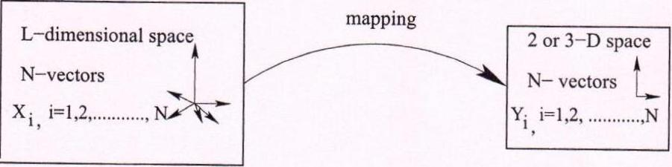
Sammon’s Non-Linear Mapping

Slide 9
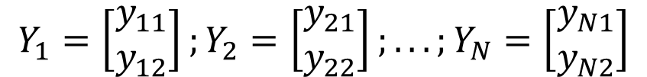
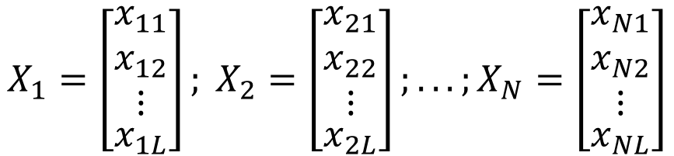
N points in L-D space are represented as follows:
$${{X_{1}=\left[\begin{aligned}\begin{matrix}x_{11} \\ x_{12} \\ ⋮\end{matrix} \\ x_{1L}\end{aligned}\right]; X}_{2}=\left[\begin{aligned}\begin{matrix}x_{21} \\ x_{22} \\ ⋮\end{matrix} \\ x_{2L}\end{aligned}\right];...;X}_{N}=\left[\begin{aligned}\begin{matrix}x_{N1} \\ x_{N2} \\ ⋮\end{matrix} \\ x_{NL}\end{aligned}\right]$$
N points in 2D plane are expected as follows:
$${{Y_{1}=\left[\begin{aligned}y_{11} \\ y_{12}\end{aligned}\right];Y}_{2}=\left[\begin{aligned}y_{21} \\ y_{22}\end{aligned}\right];...;Y}_{N}=\left[\begin{aligned}y_{N1} \\ y_{N2}\end{aligned}\right]$$

Slide 10
Steps
Step 1: Generate N points in 2D plane at random
Step 2: Calculate
d_{ij}* : Euclidean distance between two points in L-D,
say X_{i} and X_{j}
Calculate
d_{ij} : Euclidean distance between the corresponding
two mapped points in 2-D, say Y_{i} and Y_{j}
For perfect mapping d_{ij}* = d_{ij}

Slide 11
Step 3: Mapping error in m^{th} iteration
where
and

Slide 12
Step 4: Mapping error is minimized using a steepest descent method
where MF is a magic factor (0.0,1.0) and
Note: It is an iterative method and
computationally expensive.

Slide 13
VISOR Algorithm
Geometrical method for mapping from higher dimensional
space to lower dimensional space
Distance preserving tool
Problem: L-dimensional N data points are to be mapped
into 2D Plane

Slide 14
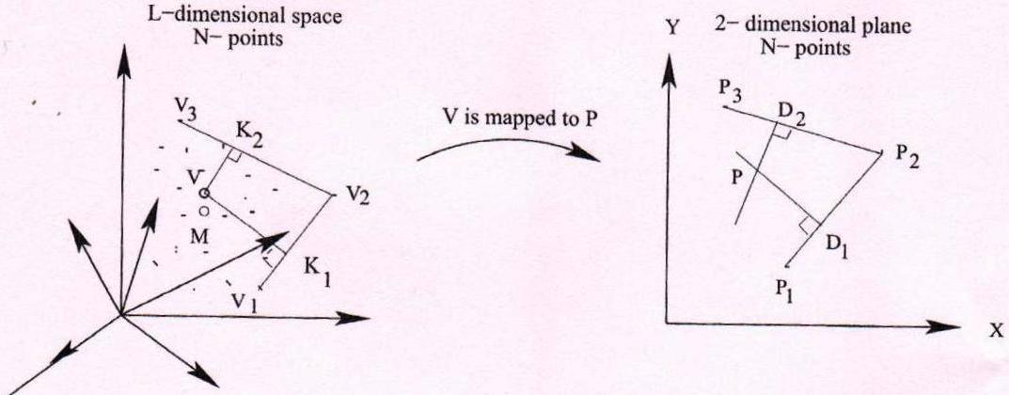
VISOR Algorithm

Slide 15
Steps
Step 1: Locate the pivot points: V₁,V₂ and V₃ in L-D space, which is a convex enclosure to the remaining data points
Compute centroid M of all data points N in the original L-D space
Determine the pivot point V₁ such that
d(V₁,M) = max (d(v_{i}, M))
Determine the pivot point V₂ such that
d(V₂,V₁) = max (d(v_{i}, V₁))

Slide 16
Determine the pivot point V₃ such that
d(V₃,V₂) = max (d(v_{i}, V₂)) and
d(V₃,V₁) = max (d(v_{i}, V₁))
Step 2: Locate the pivot points P₁,P₂ and P₃ in 2-D
plane corresponding to the points V₁,V₂ and
V₃, respectively, using the information of
Euclidean distance

Slide 17
Step 3: Mapping of the remaining (N-3) points will be done as
follows:
Say point V of L-D space is to be mapped to a
corresponding point in 2-D plane. Draw the lines V₁V₂
and V₂V₃. Draw two perpendicular lines from the point V
to the straight lines V₁V₂ and V₂V₃. Thus, the points K₁ and
K₂ are obtained on the lines V₁V₂ and V₂V₃, respectively.

Slide 18
Locate D₁ on the line P₁P₂ such that
V₁K₁ : K₁V₂ = P₁D₁ : D₁P₂
Similarly, locate D₂ on the line P₂P₃ so that
V₂K₂ : K₂V₃ = P₂D₂ : D₂P₃
Draw perpendiculars at the points D₁ and D₂ to the
lines P₁P₂ and P₂P₃, respectively. They intersect at the point p.
Thus, the point V of L-D space is mapped to a point P in 2-D
plane
Note: Mapping is done in one iteration only. It is faster than NLM algorithm

Slide 19
Self-Organizing Map (SOM)
Proposed by T.Kohonen before 1995
It can be used as visualization technique or dimensionality
reduction technique (topology preserving tool)
It woks based on unsupervised and competitive learning
Non-linear generalization of principal component analysis
Consists of two layers: Input layer and competition layer
On competition layer, there are three basic operations,
namely competition, cooperation and updating

Slide 20
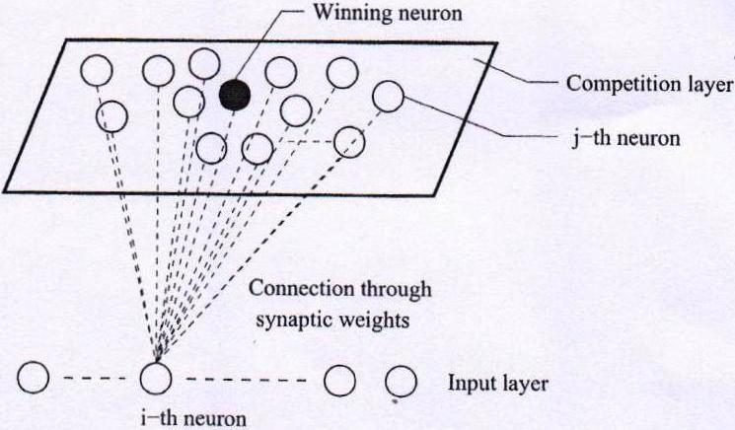
Self-Organizing Map (SOM)

Slide 21
Competition
Let us assume that there are N points (neurons) in the input layer
and each point has m dimension
X_{i} = [x_{i1}, x_{i2},.. . . . , x_{im}]^{T},
where i =1, 2, . . . . ., N and m=L
Let the synaptic weight vector between input neuron i and
neuron j lying in the competition layer is denoted by
where j =1, 2, . . . . , N

Slide 22
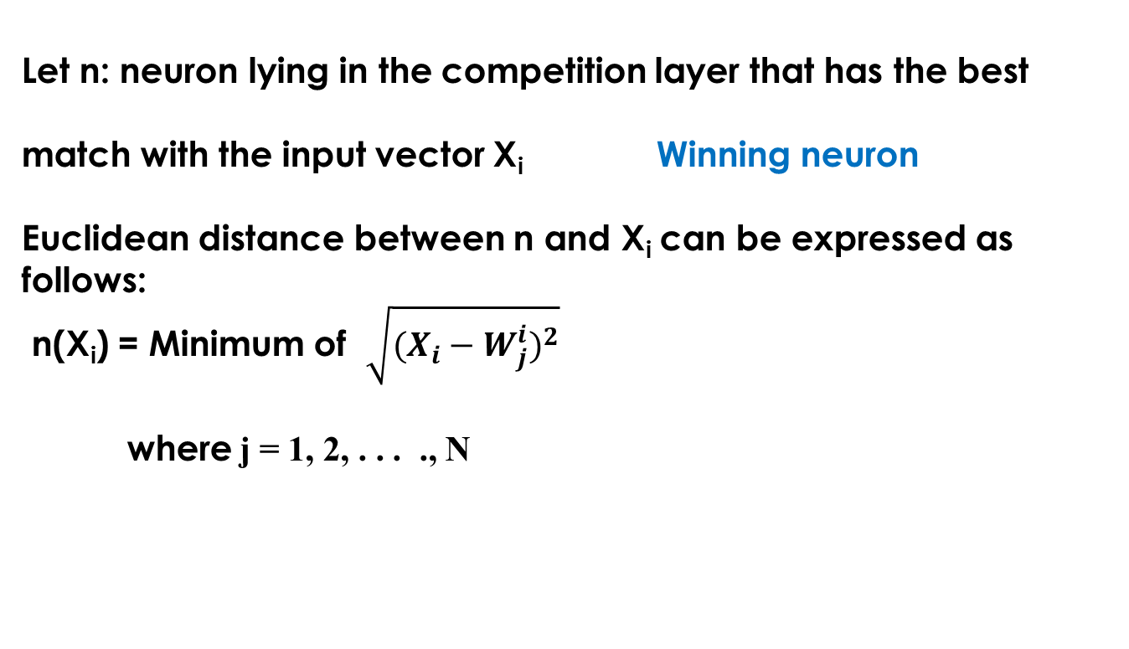
Let n: neuron lying in the competition layer that has the best
match with the input vector X_{i} Winning neuron
Euclidean distance between n and X_{i} can be expressed as follows:
n(X_{i}) = Minimum of $\sqrt{(X_{i}−W_{j}^{i})^{2}}$
where j = 1, 2, . . . ., N

Slide 23
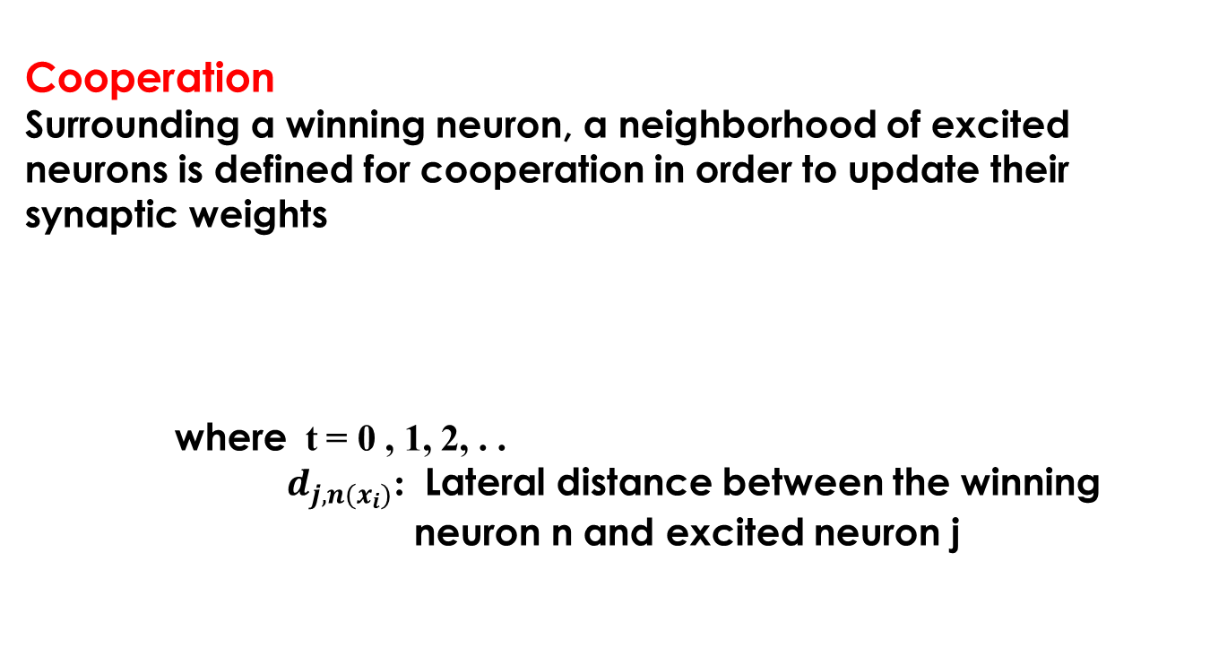
Cooperation
Surrounding a winning neuron, a neighborhood of excited neurons is defined for cooperation in order to update their synaptic weights
where t = 0 , 1, 2, . .
$d_{j,n(x_{i})}$: Lateral distance between the winning
neuron n and excited neuron j

Slide 24
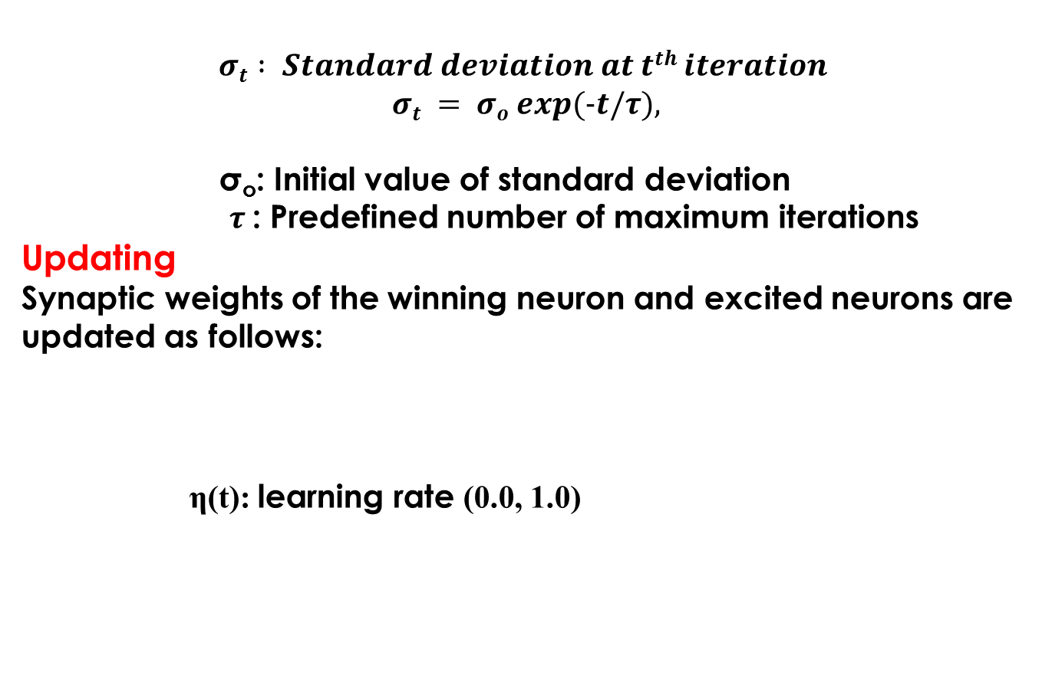
$$σt = σo exp(−t/τ),σt : Standard deviation at tth iteration$$
σ_{o}: Initial value of standard deviation
$τ$: Predefined number of maximum iterations
Updating
Synaptic weights of the winning neuron and excited neurons are updated as follows:
η(t): learning rate (0.0, 1.0)

Slide 25
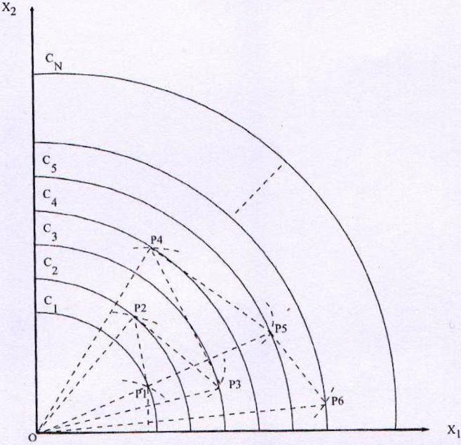
Final Mapping

Slide 26
Simulation Results
Schaffer’s F1:

Slide 27
Simulation Results

Slide 28
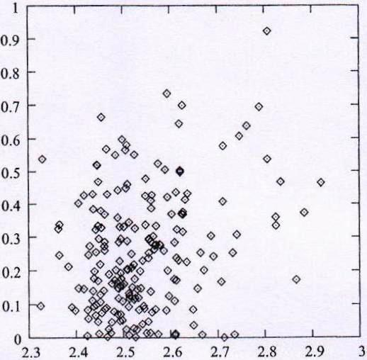
Sammon’s NLM
VISOR Algorithm
SOM

Slide 29
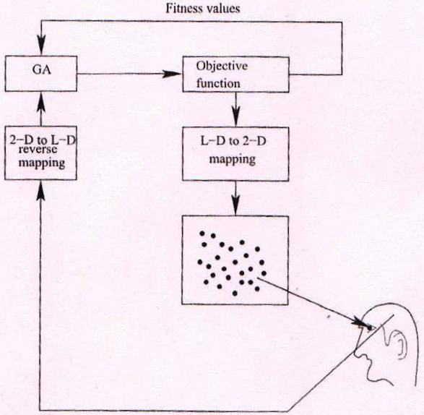
Working Principle of the VIGA
Note: VIGA is found to be almost five times faster than SGA

